Slide 1
Impedance Control
2R Robotics Arm Example
——————————————
Jonathan Oh, Zitao Yu

Slide 2
Impedance Control
2R Robotics Arm Example
Objective:
Realize Impedance control on a MATLAB Model
Reference:
Matthew Sheen,
MATLAB Impedance Control for a 2-Link Robot Arm - User-interactive
https://github.com/mws262/MATLABImpedanceControlExample

Slide 3

Impedance Control
2R Robotics Arm Example
Introduction
________________________________________________________________
Basing on Valency’s paper[1],
General Impedance control equations:
$$\left\{\begin{aligned}H\left(q\right)\ddot{q}+h\left(q,\dot{q}\right)=τ+J^{T}F_{int} \\ F_{int}=K\left(x_{o}−x_{r}\right)+B\left(\dot{x_{o}}−\dot{x_{r}}\right)−M\ddot{x_{r}}\end{aligned}\right.$$
Dynamical-based impedance control (DB-IC)
$$τ_{DB−IC}=−J^{T}F_{int}+h\left(q,\dot{q}\right)+H\left(q\right)J^{−1}\left(M^{−1}×\left\{K\left[x_{0}−L\left(q\right)\right]+B\left({\dot{x}}_{0}−J\dot{q}\right)−F_{int}\right\}−\dot{J}\dot{q}\right)$$
Position-based impedance control (PB-IC)
$$F_{int}=K\left(x_{o}−x_{m}\right)+B\left(\dot{x_{o}}−\dot{x_{m}}\right)−M\ddot{x_{m}}$$
$$τ_{PB−IC}=−J^{T}F_{int}+h\left(q,\dot{q}\right)+H\left(q\right)×[\ddot{q}+D_{PB}\left({\dot{q}}_{d}−{\dot{q}}_{r}\right)+P_{PB}\left(q_{d}−q_{r}\right)]$$

Slide 4
Impedance Control
2R Robotics Arm Example
Main tasks we accomplished:
Separate the controller calculation frequency from physical one
Establish dynamical-based impedance control (DB-IC) and position-based impedance control (PB-IC) on the existing model
Tuning of the controller parameters for a better performance

Slide 5
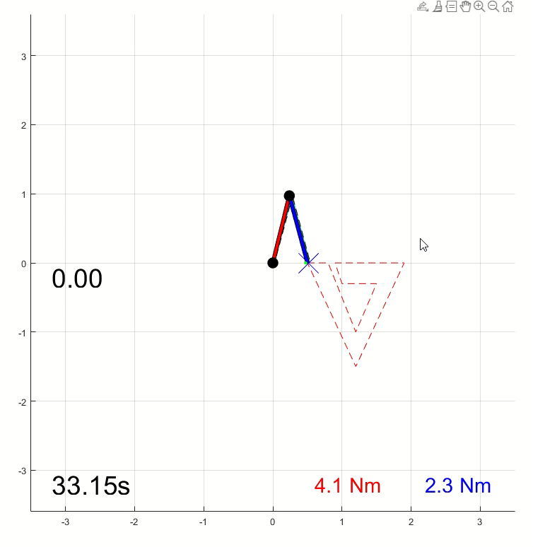
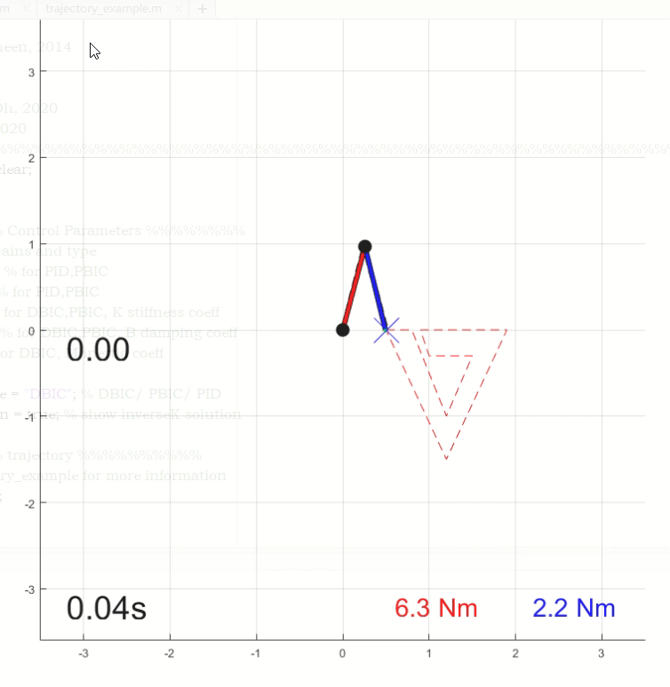
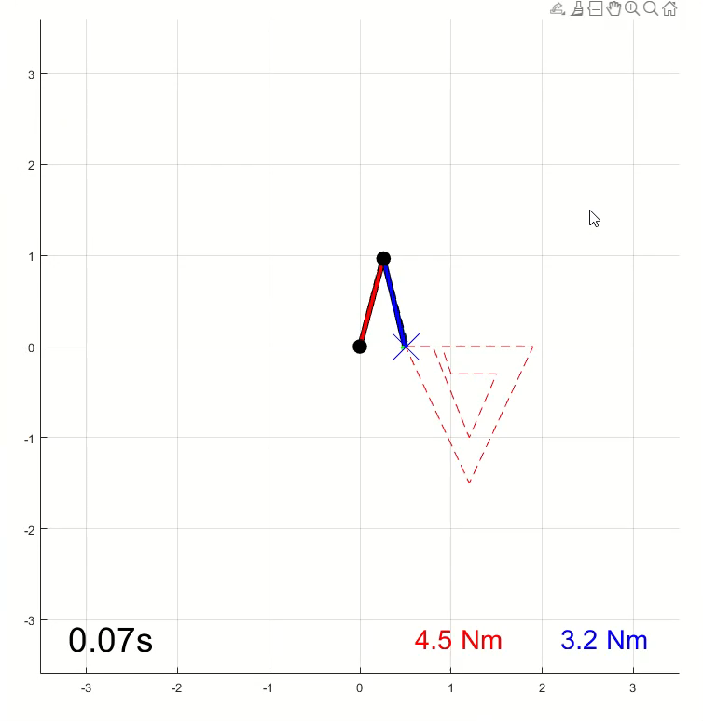
Impedance Control
2R Robotics Arm Example
Comparation with variation of controller types, without walls
PID
DB-IC
PB-IC

Slide 6
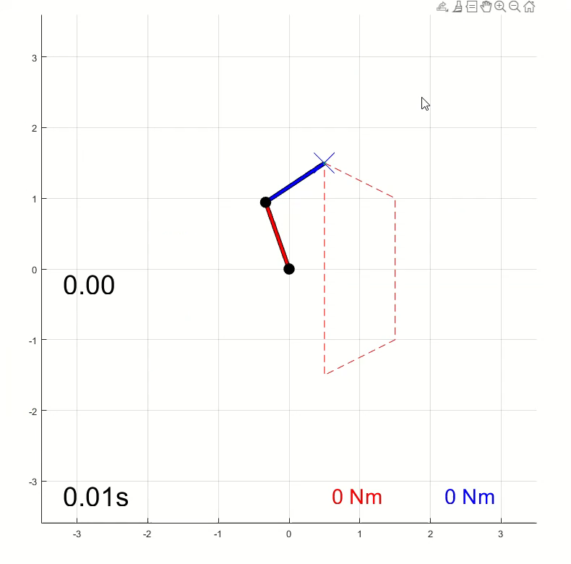
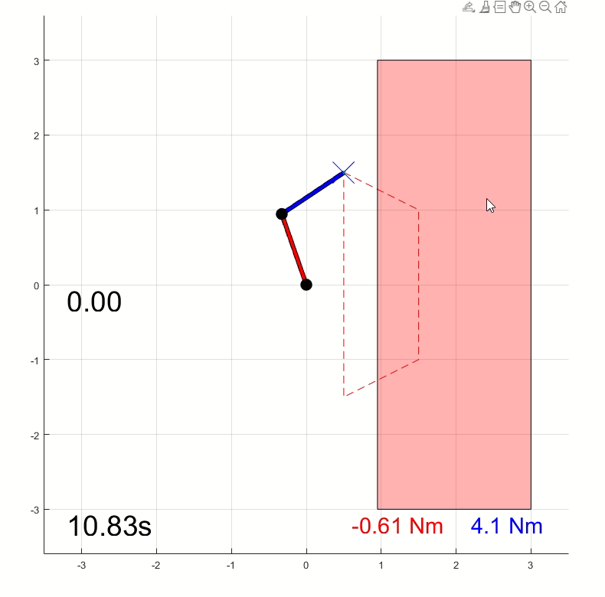
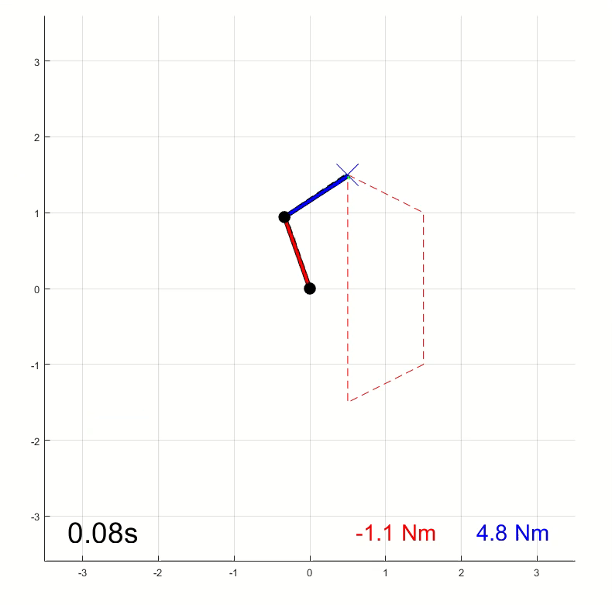
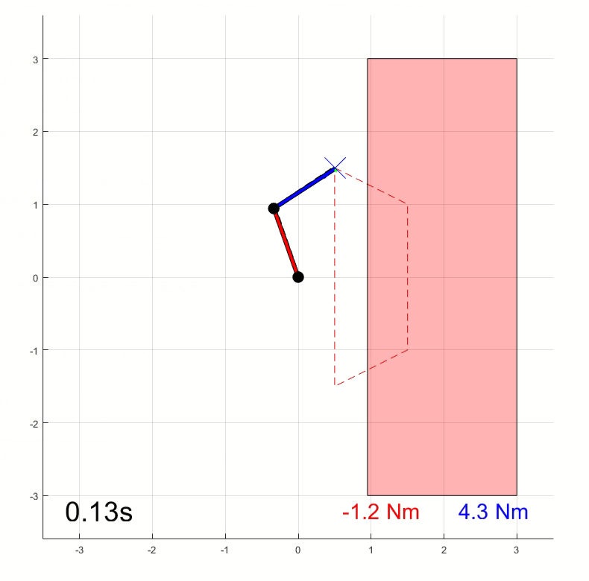
Impedance Control
2R Robotics Arm Example
Comparation with variation of controller types and existence of walls
DB-IC
PB-IC

Slide 7
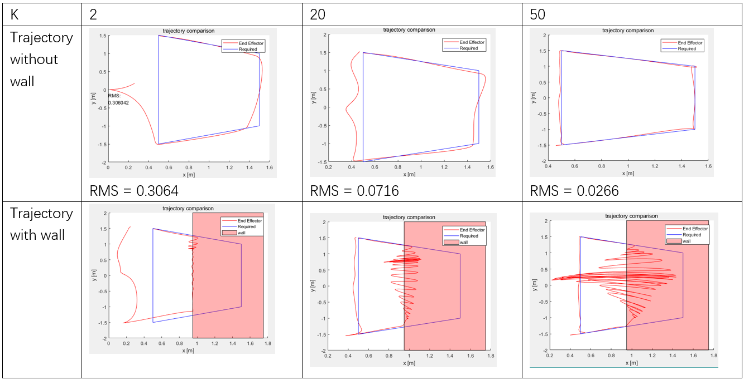
Impedance Control
2R Robotics Arm Example
Comparation with variation of K value on DB-IC model

Slide 8
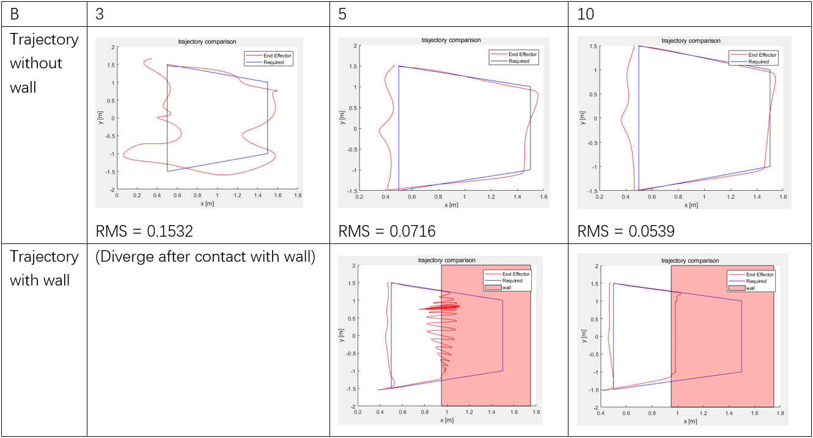
Impedance Control
2R Robotics Arm Example
Comparation with variation of B value on DB-IC model

Slide 9
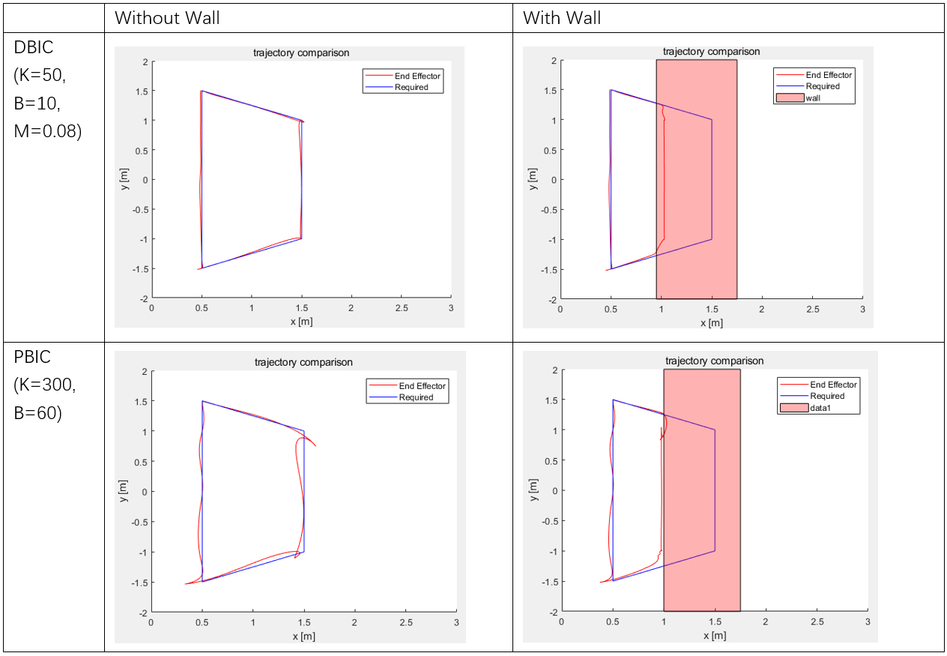
Improved Performance

Slide 10
Impedance Control
2R Robotics Arm Example
Discussion
________________________________________________________________
Generally
The larger stiffness value K, the faster tracking can be realized, however the motion will be stiffer with undesired oscillatory motions when large velocity change occurs.
Increasing the value of B will significantly smoothen the trajectory and return a better tracking.
For PB-IC Controller
Less oscillation after contact
Easily diverge at some specific configuration of the trajectory
Tracking behavior not so optimal when the movement of the desired end effector is slow, might be a result of systematic error when solving ode.
Can’t reach high K value, numerical limited.

Slide 11
Impedance Control
2R Robotics Arm Example
Questions
_____________________

Slide 12
Impedance Control
2R Robotics Arm Example
Thank You!
_____________________

